Slide 1
CREDIT CARD FRAUD DETECTION USING MACHINE LEARNING
- A CASE STUDY BY IMON GHOSH

Slide 2
TABLE OF CONTENTS
01
04
About the Project
Data Preparation
02
05
Objective of the Analysis
Results Interpretation
03
06
Exploratory Data Analysis
Business Recommendations

Slide 3
ABOUT THE PROJECT
The dataset comprises of credit card transactions in September 2013 by European cardholders.
It presents transactions that occurred in two days, where we have 492 frauds out of 284,807 transactions.
The dataset is highly unbalanced as the positive class (frauds) account for nearly 0.2% of all transactions.

Slide 4
OBJECTIVE OF THE ANALYSIS
It is of utmost importance that credit card companies are able to recognize fraudulent credit card transactions so that customers are not charged for items that they did not purchase.
Amid the ongoing digital revolution, there has been a substantial increase in credit card payments which has resulted in increased fraudulent transactions.
So, the main purpose of the analysis is to build a model using machine learning algorithms that can predict fraudulent credit card transactions.

Slide 5


EXPLORATORY DATA ANALYSIS
Features V1, V2, … V28 are the principal components obtained with PCA, the only features which have not been transformed with PCA are 'Time' and 'Amount'.
Feature 'Time' contains the seconds elapsed between each transaction and the first transaction in the dataset.
The feature 'Amount' is the transaction Amount.
Feature 'Class' is the response variable and it takes value 1 in case of fraud and 0 otherwise.

Slide 6
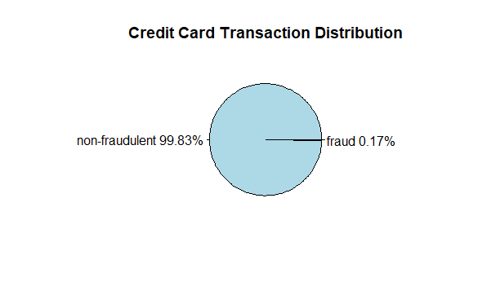
DISTRIBUTION OF CLASS VARIABLE

Slide 7
DATA PREPARATION
Random Under Sampling/Random Over Sampling
Both Random Under Sampling and Random Over Sampling together.
Synthetic Minority Oversampling Technique (SMOTE)
Since the dataset is highly unbalanced, we use the following sampling methods:
Time’ feature does not indicate the actual time of the transaction and is more of listing the data in chronological order. Since it has little or no significance in correctly classifying a fraud transaction, we have eliminated it from further analysis.

Slide 8
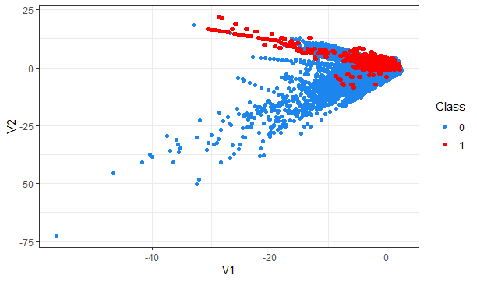
RANDOM OVER SAMPLING (ROS)
In Random Over Sampling, duplicate points are created for the fraud class (class 0), so the points are overlapping.

Slide 9
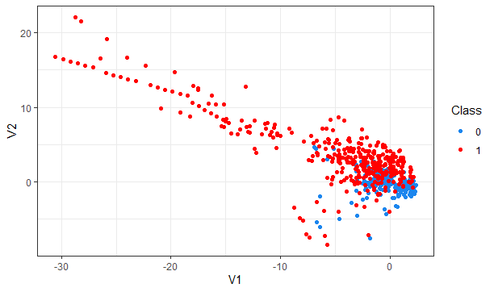
RANDOM UNDER SAMPLING (RUS)
In this case, the number of non-fraudulent cases have been decreased. However, here, we end up losing a lot of data.

Slide 10
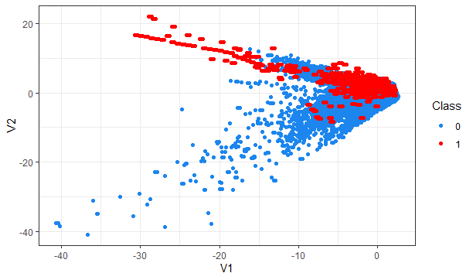
BOTH ROS AND RUS
Using both ROS and RUS, the no. of non-fraudulent transactions has been reduced and the number of fraud cases has been increased.

Slide 11
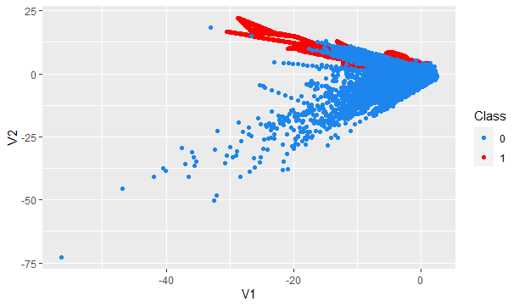
SMOTE FOR BALANCING THE DATASET
In this case, instead of duplicate data points, synthetic points have been added to the data. Around 60% of the data consists of non-fraudulent transactions and 40% consists of fraud transactions.

Slide 12
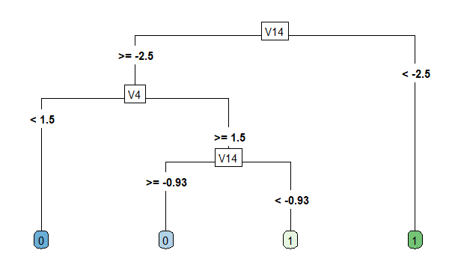
CLASSIFICATION MODEL
Since Classification is the process of predicting discrete variables (1/0) – Class variable – in this dataset, classification model has been applied for the purpose of analysis.
Decision Trees (CART) algorithm has been applied to the model.

Slide 13


RESULTS INTERPRETATION
The CART model gives an accuracy of 97.9%, while having 88.8% fraud events classified correctly and 11.2% false negatives.
The model’s positive predicted value stood at 99.9%, while negative predicted value came in at 0.07%.
F1 score, a measure of the model’s accuracy on the dataset, was greater than 90%.
Significant improvement in model performance over the imbalanced data has been achieved by applying Synthetic Minority Oversampling Technique.
We can conclude that the project has successfully explored the task of identifying fraudulent transactions using the Classification and Regression Tree algorithm.

Slide 14
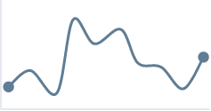

BUSINESS RECOMMENDATIONS
Since detecting fraud transactions is of great importance for any credit card company, businesses
should come up with techniques that can detect fraud automatically, while at the same time use less time
for verification methods.
Meaningful features of card users’ transactions, such as Date, User Zone, Product Category,
Provider, Client’s Behavioral Patterns etc. should be considered and run through a subtly trained
model that finds patterns and rules, so that it can classify whether a transaction is fraudulent or legitimate.
Depending on the level of predicted fraud probability, if probability is between 10% and 80%,
an additional authentication factor (e.g. a one-time SMS code or a secret question)
should be applied.
Attempts should be made to identify new suspicious patterns and create new rules
to prevent new types of scams.

Slide 15
THANKS!

